Slide 1

DSA
Week 4
Stacks
Data Structures and Algorithms (DSA)
Prescribed Module/Elective
Diploma in IT, ISF, FI
Year 2 (2018/19), Semester 4

Slide 2
Topics
Introduction of the ADT stack
Implementation of the ADT stack
Application of the ADT stack

Slide 3
References
1. Data Abstraction and Problem Solving with C++ 5th Edition
☞ chapter 6

Slide 4
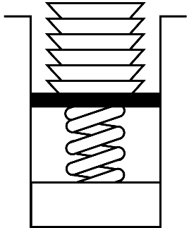
1. Stack ADT
A stack is another form of data structure for organizing data.
Important property: LIFO (Last-in First-Out)
Last item placed on the stack will be removed first.
e.g. stack of plates, books etc

Slide 5
Stack ADT
Stack ADT
is a collection of items
only item at top of stack is visible and can be retrieved.
new items can only be added to top of stack
items can only be removed from top of stack

Slide 6
2. Implementing Stack ADT
Steps
Identify and list the operations for Stack ADT
list of operations required for Stack ADT
Specify the Stack ADT interface
☞ function prototypes of the operations for Stack ADT (Stack.h)
Implement the Stack operations
☞ implementation of the operations for Stack ADT (Stack.cpp)

Slide 7
Step 1 : Identify and list the operations for Stack ADT
The purpose of this step is to identify and list the operations required for the ADT.
Operations (for Stack ADT)
create an empty stack add an item to the top of stack (push) remove an item from top of stack (pop) retrieve/ look at item at top of stack (peek or getTop) check whether the stack is empty destroy the stack

Slide 8
Step 2 : Specify the Stack ADT (Stack.h)
The purpose of this step is to specify the function prototypes/headers of each of the operations clearly
Specification of Stack ADT
Stack() push(ItemType item):Boolean pop():Boolean getTop(ItemType &item):void isEmpty():Boolean ~Stack() //for pointers-based implementation

Slide 9
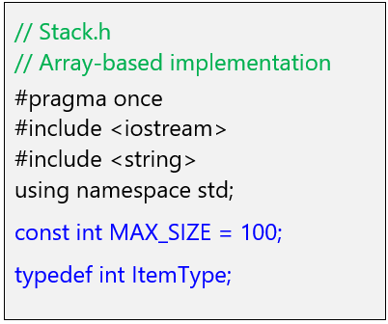
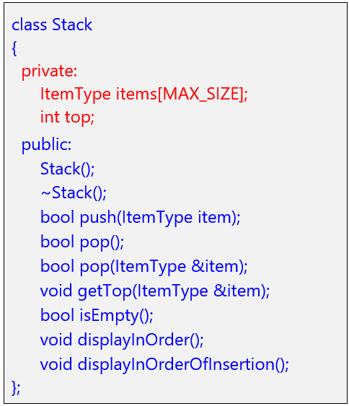
Specification of Stack ADT(Array-based) - stack.h

Slide 10
Array-based Implementation of Stack ADT
Note
Top of stack corresponds to the last occupied entry in array
pushing & popping data can only be done at top
pushing & popping data is fast (access top via index : O(1) )
number of items can be stored is limited
may waste storage (array may not be fully utilized)
MAX_SIZE -1
top = ?
…
k - 1
itemk
…
3
item4
2
item3
1
item2
0
item1
Array indices

Slide 11
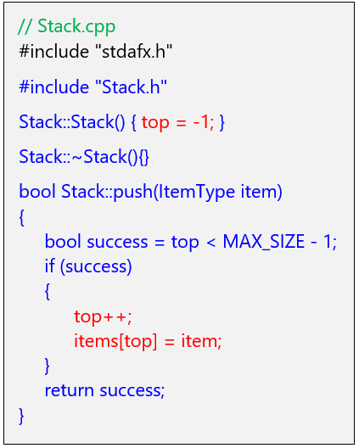
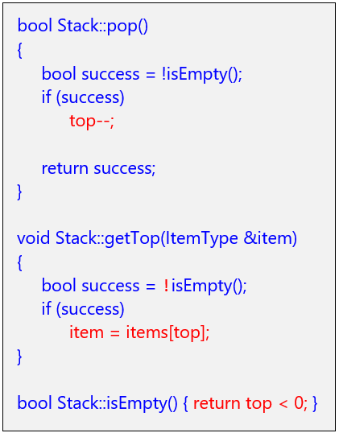
Implementing the operations (Array-based)- stack.cpp

Slide 12
Pointer-based Implementation of Stack ADT
topNode
Pointers can be used to
link data to form a stack,
as shown on the right.
Riz
item
Node
next
Likewise, need to have a inner structure known as a Node that has 2 parts:
- item (to store the data item)
- next (to store the address of next node)
Sam
item
Node
next
…
topNode
Overall Stack ADT needs:
- a pointer topNode to point to the node at top most position (initially point to NULL)
Mic
item
Node
next

Slide 13
Pointer-based Implementation of Stack ADT
topNode
Note
TopNode points to top node of stack(NB: as opposed to last item in array implementation)
pushing & popping data can only be done at top
pushing & popping data involves manipulation of linkages including topNode (fast : O(1))
Stack can dynamically grow and shrink
Additional memory need to store the linkages
Riz
item
Node
next
Sam
item
Node
next
…
Mic
item
Node
next

Slide 14
Node Structure
Recall format for declaring the node structure in C++ is:
struct Node
{
ItemType item; // to store the data item
Node *next; // pointer to point to next node
};
item
next

Slide 15
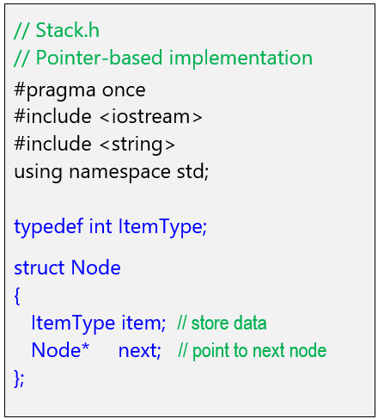
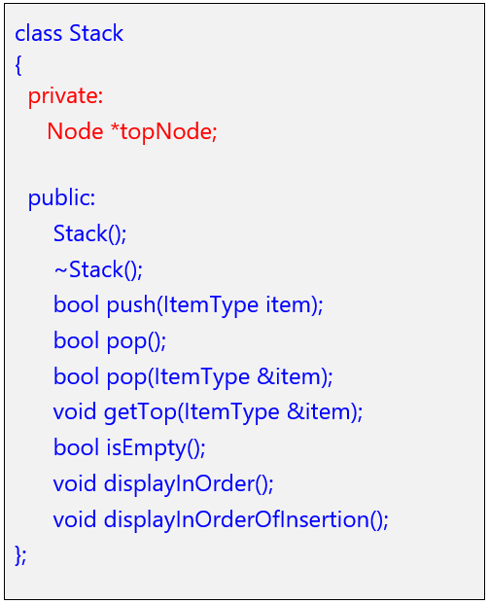
Specification of Stack ADT(Pointer-based) - Stack.h

Slide 16
Pushing an item on top of the Stack
To push a new item to the top of the List, you need to :
☞ create a new node to store the item
☞ make the new node’s next pointer point to the top node
☞ Make the topNode pointer point to new node
topNode
2
newNode
Annie
1
Mary
John

Slide 17
Algorithm : push an item on top of the Stack
boolean push(ItemType item)
Create a new node Store the item to the node Initialize the next pointer to null set new node’s next pointer to point to node pointed to by topNode set topNode (pointer) to point to new node Return true

Slide 18
Pop an item from top of the Stack
To pop item from top of the Stack, you need to :
☞ Use a temp pointer to point to top node
☞ Make the topNode point to the next node in stack
☞ Make removed node’s next pointer point to NULL and deallocate memory from removed node
2
topNode
temp
1
Annie
3
John

Slide 19
Algorithm : pop item from top of the stack
boolean pop()
If stack is not empty set temp (pointer) point to the top node make topNode(pointer) point to the next node in stack make removed node’s next (pointer) point to NULL deallocate memory from removed node

Slide 20
Algorithm : retrieving an item at top of the Stack
ItemType getTop()
If stack is not empty return the item contained in the top node

Slide 21
3. Application of Stack ADT – Balanced Parentheses
Scenario:
☞ Given a list of brackets: round ( ), square [ ] , curly { }, etc.
☞ Can we make use of stack to identify if they are balanced
e.g. {[()]}, {[)]}, {{[])}}
☞ The pseudocodes are defined as:
Algorithm checkDelimiterBalance (expression) ← main algorithm
Algorithm isPairOfDelimiters (char open, char close) ← supporting function
Download pseudocode from MEL

Slide 22
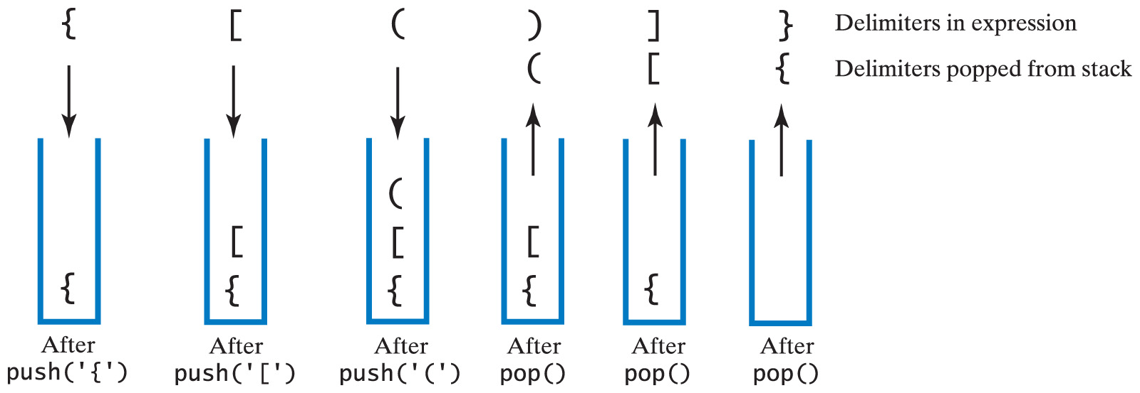
3. Application of Stack ADT – Balanced Parentheses
Checking for Balanced Delimiters ( ) , [ ], { }
Example of balanced delimiters:
Carrano, Data Structures and Abstractions with Java, Second Edition, (c) 2007 Pearson Education, Inc. All rights reserved. 0-13-237045-X

Slide 23
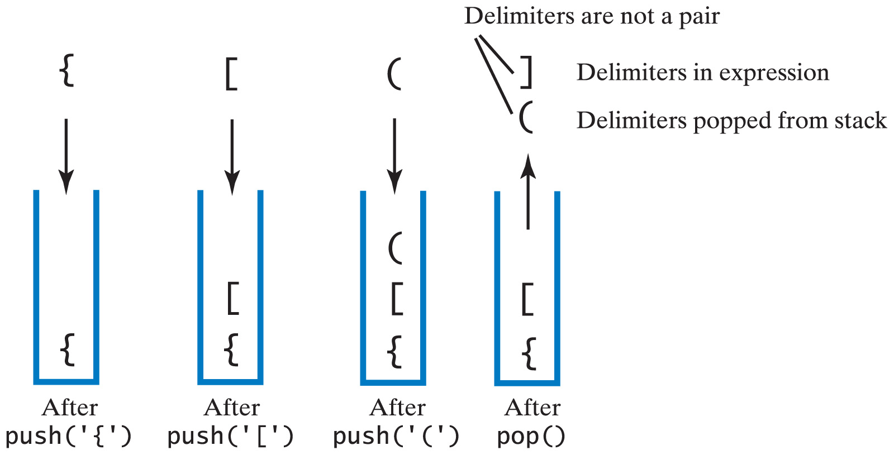
3. Application of Stack ADT – Balanced Parentheses
Example of unbalanced delimiters {[(])} :
Carrano, Data Structures and Abstractions with Java, Second Edition, (c) 2007 Pearson Education, Inc. All rights reserved. 0-13-237045-X0

Slide 24
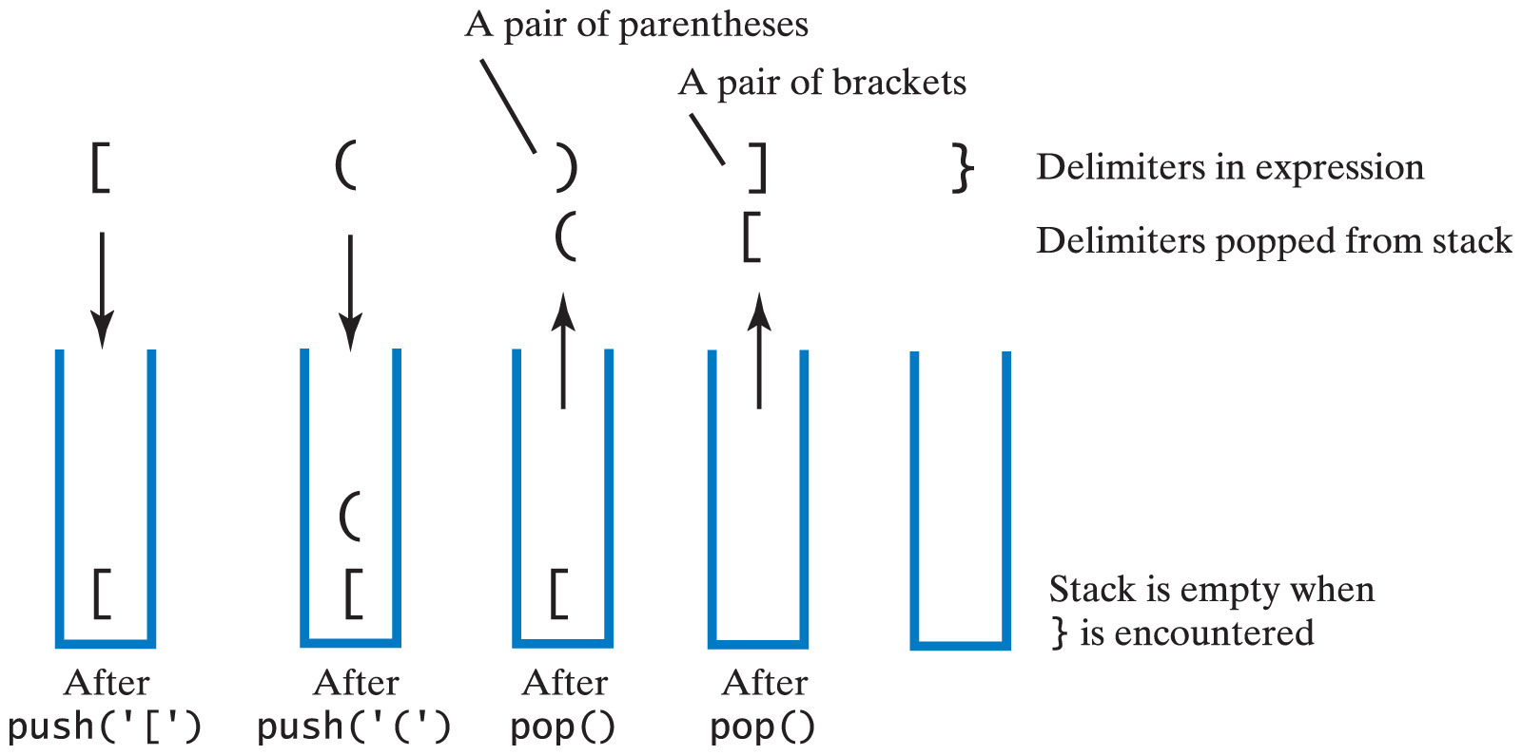
3. Application of Stack ADT – Balanced Parentheses
Example of unbalanced delimiters [()]} :
Carrano, Data Structures and Abstractions with Java, Second Edition, (c) 2007 Pearson Education, Inc. All rights reserved. 0-13-237045-X0

Slide 25
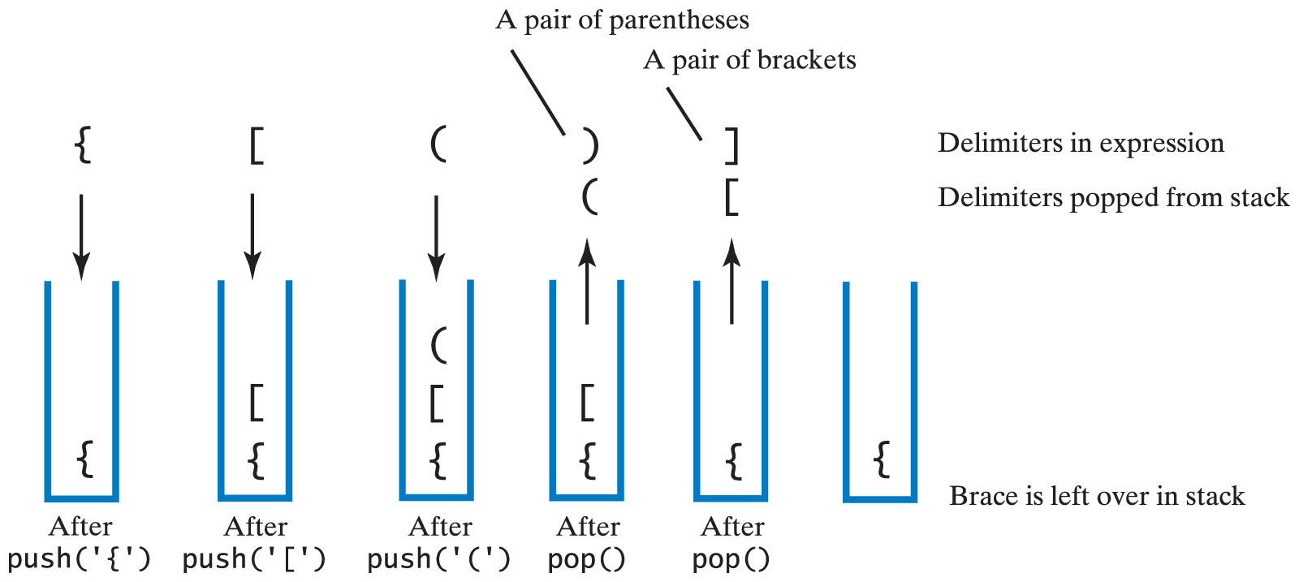
3. Application of Stack ADT – Balanced Parentheses
Example of unbalanced delimiters {[()] :
Carrano, Data Structures and Abstractions with Java, Second Edition, (c) 2007 Pearson Education, Inc. All rights reserved. 0-13-237045-X0

Slide 26
3. Application of Stack ADT – Infix to Postfix Expressions
Evaluating Algebraic Expressions
Infix expressions (what we learn in Math classes)
Binary operators appear between operands
a + b
Prefix expressions
Binary operators appear before operands
+ a b
Postfix expressions
Binary operators appear after operands
a b +
Easier to process – no need for parentheses nor precedence
-> compilers normally transform infix expression to postfix form
before solving the expression

Slide 27
Evaluating Algebraic Expressions
How to solve Postfix Expressions by hand?
Example:
For an infix expression: (4+5) * 3 -7
=> Postfix expression would be:
Steps:
Work thru expression from L to R.
Everytime encounter an operator,
evaluate the two operands that
came before it.
Save the result of operation
Continue until evaluation of entire expression
4 5 + 3 * 7 -
= 9 3 *
= 27 7 -
= 20
Notice that no parantheses needed!!

Slide 28
Evaluating Algebraic Expressions
How about Transforming Infix to Postfix by hand?
Example:
Given an infix expression: (3+6) * (2- 4) + 7
Fully paranthesize it (((3+6) * (2- 4)) +7), then do this:
(((3+6) * (2 - 4)) +7)
3 6+ 2 4 - * 7+

Slide 29
Transformation of Infix to Postfix
How do we program it?
=> Need to use Stack
=> works for infix expression that’s fully paranthesized or not.
The Big Picture:
Operands are always output immediately, since they appear before the operator in the postfix expression.
Operators always pushed into the stack, since they always appear later in the postfix expression.
( is always pushed into stack, since must be paired with corresponding ).

Slide 30
Transformation of Infix to Postfix
) should never be pushed into stack, always force popping from the stack, since that means those that were JUST pushed into the stack has higher precedence.
For non-fully paranthesized infix expression, no problem as long as give the operations in stack higher precedence than same class of operation in input.

Slide 31
Transformation of Infix to Postfix
Symbol in Infix | Action
Operand | Append to end of output expression
Operator ^ | Push ^ onto stack
Operator +,-, *, or / | Pop operators from stack, append to output expression until top has lower precedence than new operator (or stack empty). Then push new operator onto stack
Open parenthesis ( | Push ( onto stack
Close parenthesis | Pop operators from stack, append to output expression until we pop an open parenthesis. Discard both parentheses.

Slide 32
Transformation of Infix to Postfix
Operator Precedence Table (in the midst of Infix to Postfix transformation)
Precedence between “character in the stack” and current character under consideration
 | Precedence
Operator | Stack | Input
) | N/A (never pushed in) | 0
( | 0 | 7 (always pushed in)
+, - | 2 (higher rank than input) | 1
*, / | 4 (higher rank than input) | 3
^ | 6 (higher rank than input) | 5

Slide 33
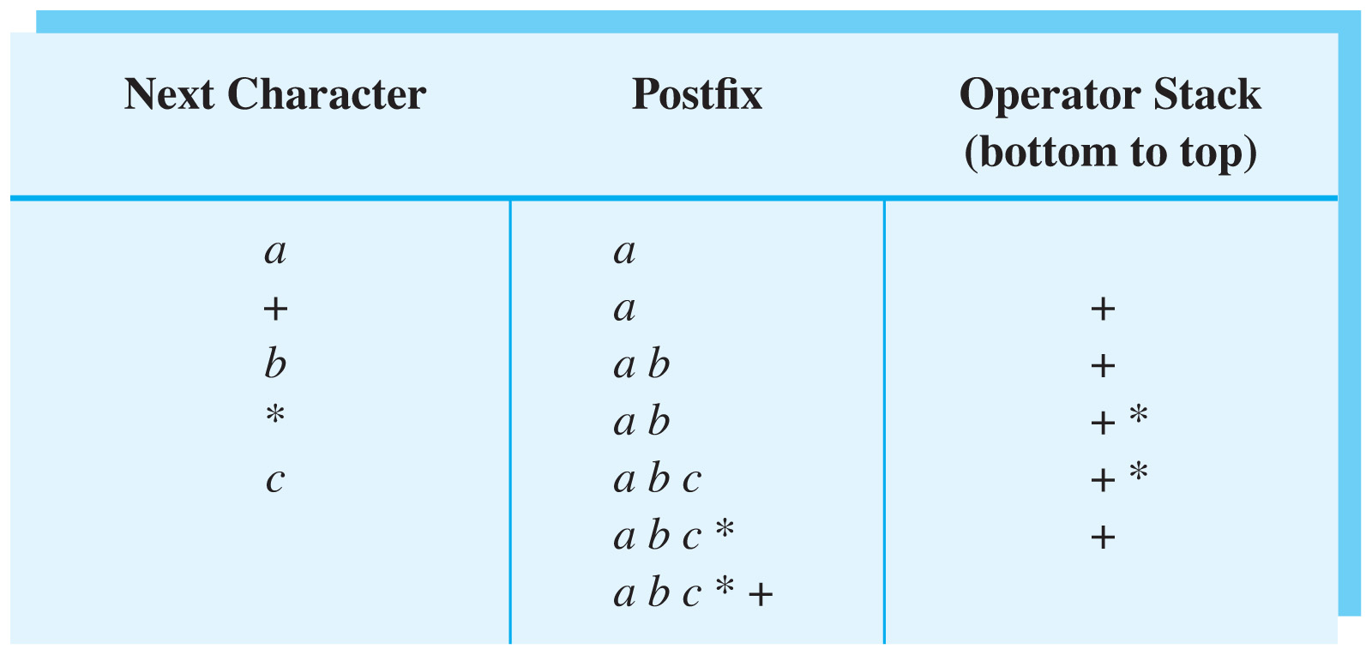
Transformation of Infix to Postfix
Example:
Converting the infix expression a + b * c to postfix form
Carrano, Data Structures and Abstractions with Java, Second Edition, (c) 2007 Pearson Education, Inc. All rights reserved. 0-13-237045-X0
Notes:
Bc*a+

Slide 34
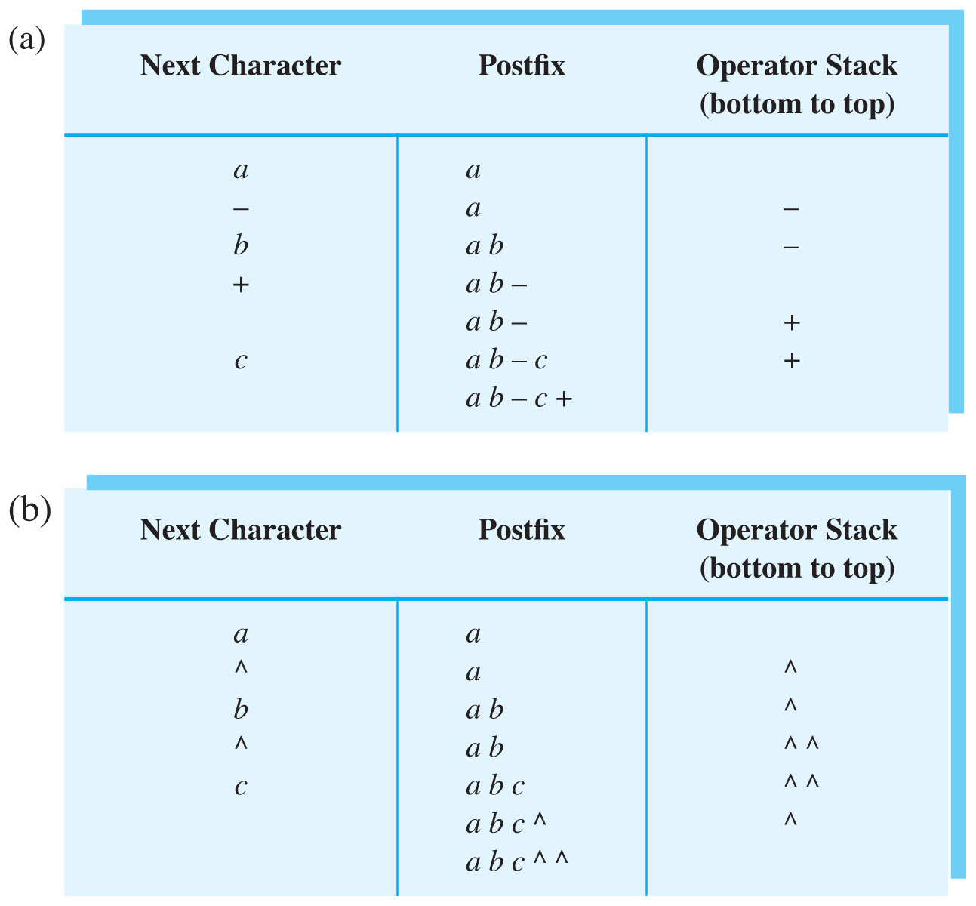
Transformation of Infix to Postfix
Example:
Converting infix expression a – b + c to postfix form:
Carrano, Data Structures and Abstractions with Java, Second Edition, (c) 2007 Pearson Education, Inc. All rights reserved. 0-13-237045-X0

Slide 35
Transformation of Infix to Postfix
Example:
Converting infix expression a ^ b ^ c to postfix form:
Carrano, Data Structures and Abstractions with Java, Second Edition, (c) 2007 Pearson Education, Inc. All rights reserved. 0-13-237045-X0

Slide 36
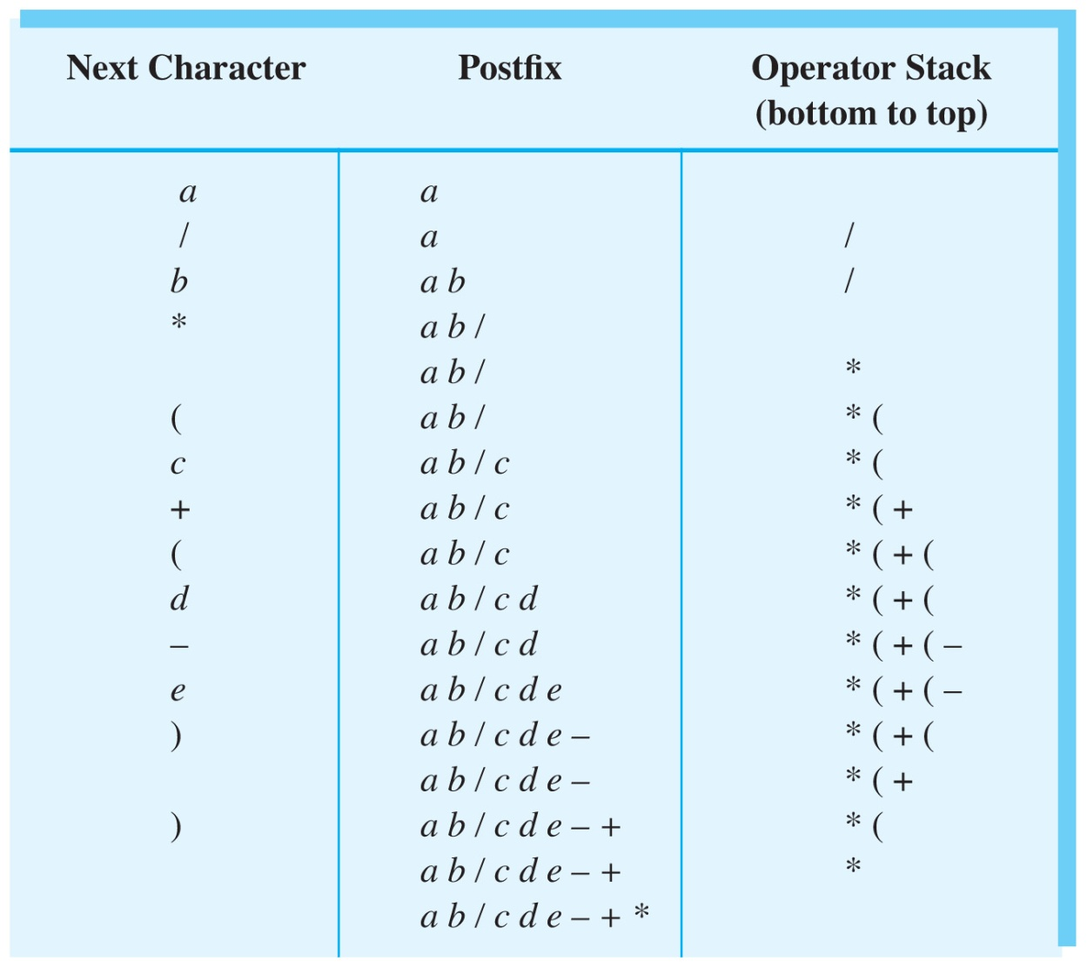
Transformation of Infix to Postfix
Download pseudocode from MEL
Example:
Convert infix expression a / b * ( c + ( d - e ) ) to postfix form :
Carrano, Data Structures and Abstractions with Java, Second Edition, (c) 2007 Pearson Education, Inc. All rights reserved. 0-13-237045-X0

Slide 37
Evaluating Postfix Expressions
Beautiful thing about postfix notation:
easy implementation using a stack.
Steps:
Read in one symbol at a time from postfix expression
Anytime you see an operand, push it onto the stack
Anytime you see a binary operator(+, -, *, /) or unary
(square root, negative sign) operator,
If the operator is binary, pop two elements off the stack
If the operator is unary, pop one element off the stack
Evaluate those operands with that operator
Push the result back into the stack
When you are done with the expression,
only thing left in stack is the final result!!

Slide 38
Evaluating Postfix Expressions
Note:
1st element popped off the stack should go to RHS of operator.
This is very important for subtraction and division!
Download pseudocode from MEL

Slide 39
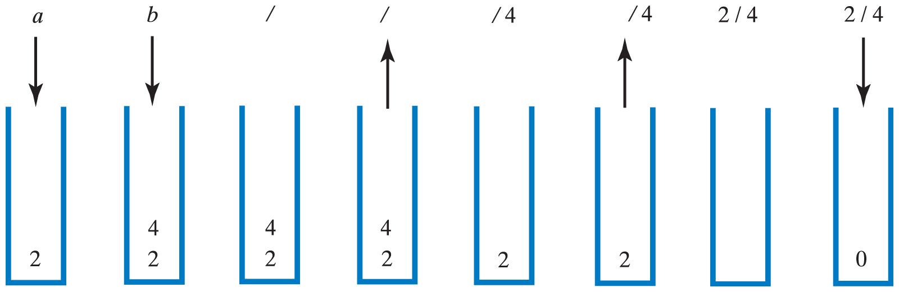
Evaluating Postfix Expressions
Example:
Evaluation of the postfix expression a b / when a is 2 and b is 4
Carrano, Data Structures and Abstractions with Java, Second Edition, (c) 2007 Pearson Education, Inc. All rights reserved. 0-13-237045-X0

Slide 40
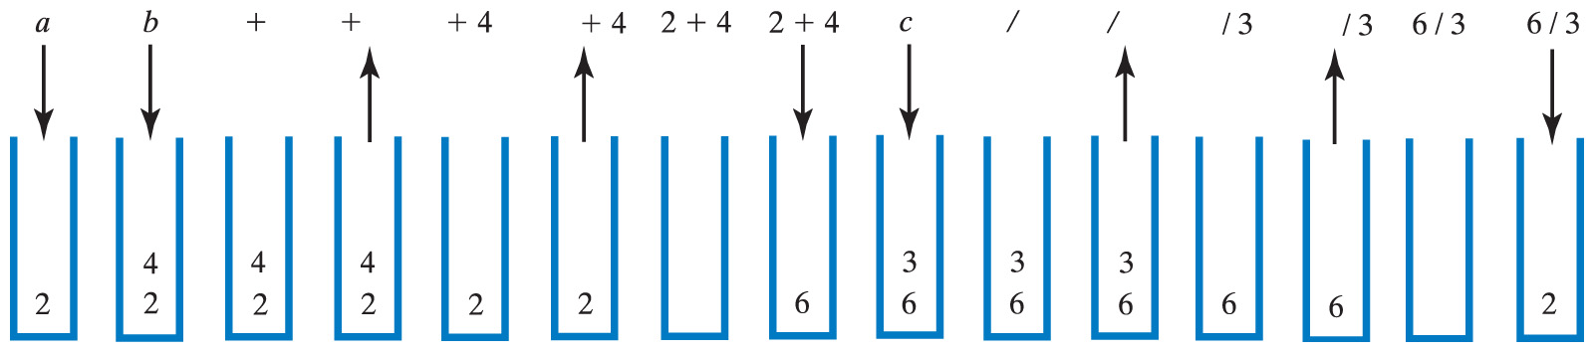
Evaluating Postfix Expressions
Example:
Evaluation of the postfix expression a b + c / when
a is 2, b is 4 and c is 3
Carrano, Data Structures and Abstractions with Java, Second Edition, (c) 2007 Pearson Education, Inc. All rights reserved. 0-13-237045-X0

Slide 41
Evaluating Infix Expressions
Implementing infix notation is much more difficult.
Steps:
Use two stacks: one for operators, one for operands
Keep pushing elements onto their respective stacks until you reach a closed parenthesis.
When encounter a closed parenthesis
pop an operator off the operator stack
Pop the appropriate number of operands
Perform the operation
Push the result into operand stack
When you are done with the expression,
only thing left in stack is the final result!!
Carrano, Data Structures and Abstractions with Java, Second Edition, (c) 2007 Pearson Education, Inc. All rights reserved. 0-13-237045-X0

Slide 42
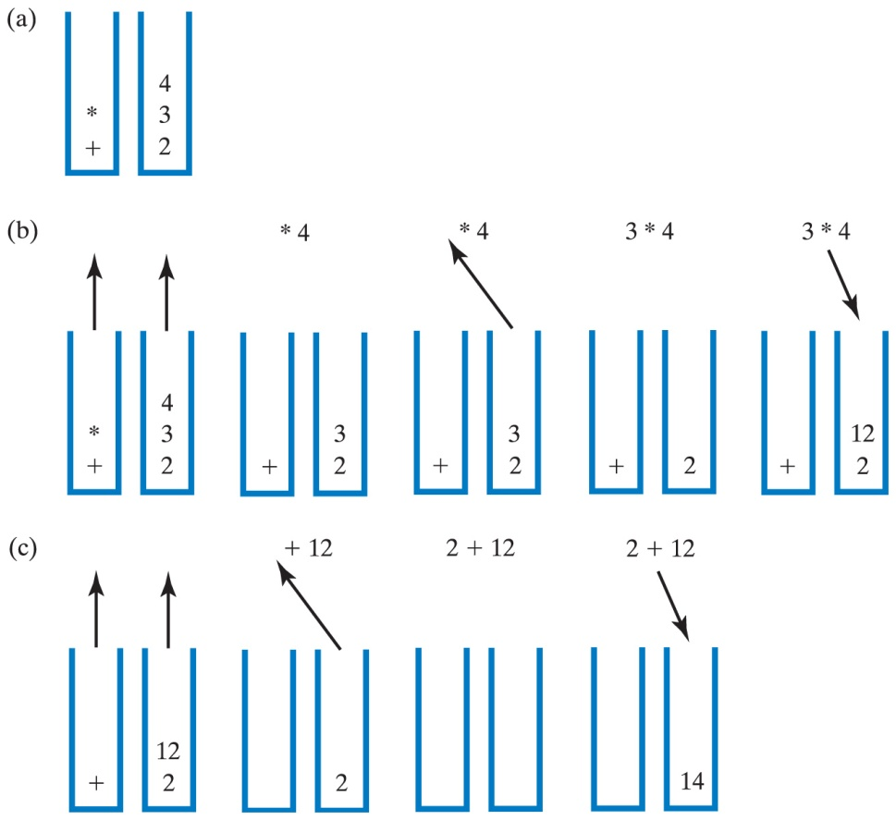
Evaluating Infix Expressions
Evaluation of 2 + 3 * 4 when a = 2, b = 3, c = 4;
(a) after reaching end of expression; (b) while performing multiplication; (c) while performing the addition
Download pseudocode from MEL
Carrano, Data Structures and Abstractions with Java, Second Edition, (c) 2007 Pearson Education, Inc. All rights reserved. 0-13-237045-X0

Slide 43
Some points to note
1. Again, format for specifying the ADT operations may vary
e.g.
getTop(int index):ItemType // format 1
push(ItemType item):boolean // format 1
getTop(ItemType &item):void // format 2
push(ItemType &item):void // format 2
2. In C++, a node, if removed, should be returned to the
system(or memory deallocated) using the keyword delete
e.g.
delete removedNode;

Slide 44
Summary
Introduction of the ADT stack
Implementation of the ADT stack
Application of the ADT stack

